Slide 1
Customer Churn in retail chain
By Gummadi Sai Dheeraj

Slide 2
Scope of the Presentation
Understand Customer Churn
Need of Data Driven Approach for Tackling Customer Churn
Role of Machine Learning in Reducing Customer Churn
Machine Learning canvas for Retail Customer Churn
Costs and Considerations
Conclusion

Slide 3
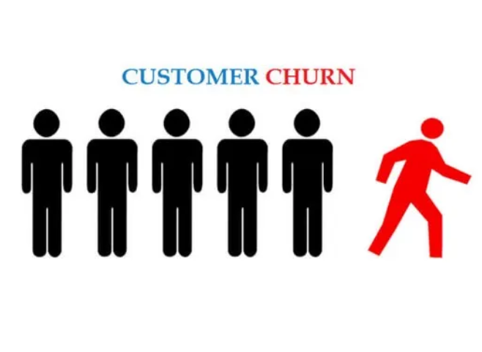
Understanding Churn
Percentage of lost customers compared to the total number of customers during that period.
Customer Churn Rate = (churned customers / total customers at the start of period) x 100
Revenue Churn Rate = (churned revenue / total revenue at start of period) x 100
Example: Let’s say we have two worth $500, two worth $400, two worth $300, two worth $200, and two worth $100 that sum up to $3000

Slide 4
Customer Churn in Retail: Need of Data-Driven Approach
Customer churn, the loss of customers to competitors, is a critical challenge in the retail industry.
According to (Zarema P), Companies lose $1.6 trillion due to customer churn.
Retaining existing customers is significantly more cost-effective than acquiring new ones,
Implementing a data-driven approach to predict and prevent churn is essential for:
Maintaining profitability and sustainable growth
Reducing revenue loss
Reducing Higher customer acquisition costs
Maintaining brand reputation

Slide 5
Machine Learning: The Game-Changer
We can leverage the power of Machine Learning to predict customer churn with remarkable accuracy.
Identify at-risk customers
Implement targeted strategies to retain them
Improve customer segmentation

Slide 6
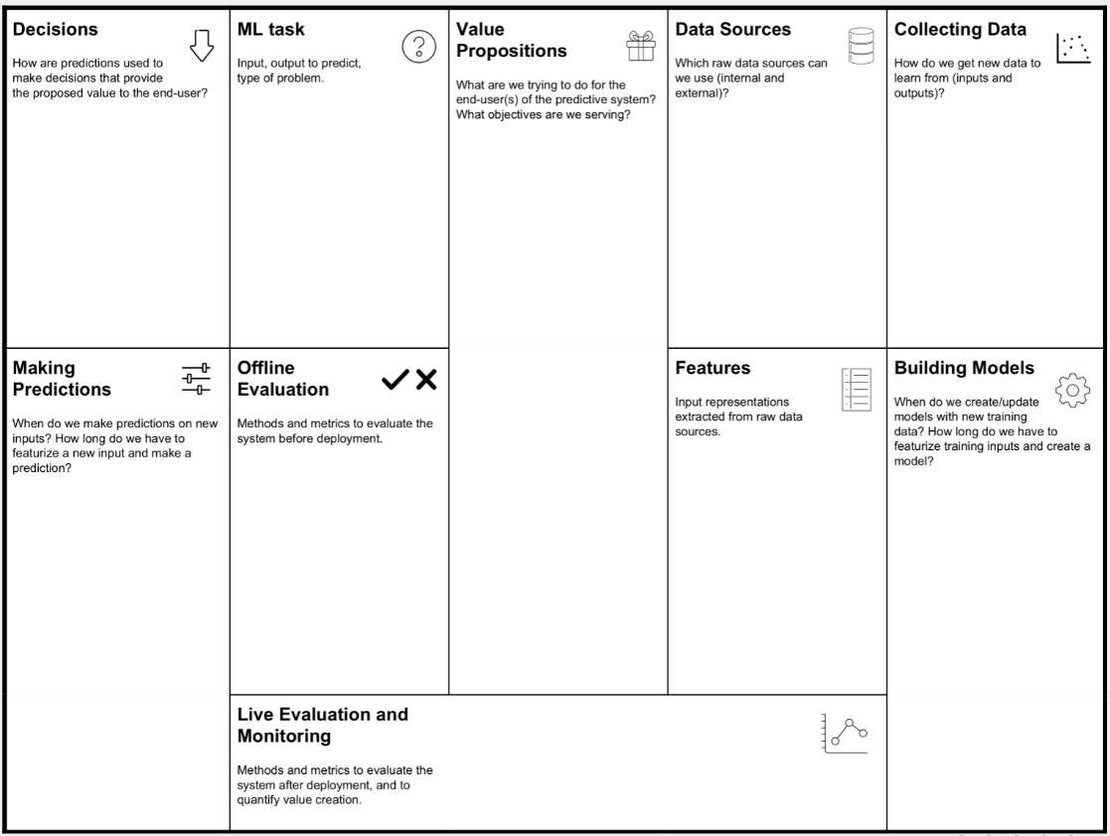
Machine Learning Canvas: Our Blueprint for Success
Decisions
Machine Learning Task
Value Propositions
Data Sources
Data Collection
Making Predictions
Offline Evaluation
Features
Building Models
Model Monitoring

Slide 7
How are ML predictions used to take decisions?
Our ML model will predict the probability of a customer churning within a specific timeframe (e.g., next 3 months). This information will be used to:
Target marketing campaigns
Customer service interventions
Product and service optimization
Pricing strategies

Slide 8
Data Sources
Internal Sources
Customer loyalty program: Valuable data on purchase history, product preferences, and redemption behavior.
Point-of-sale (POS) systems: Comprehensive transaction data from our physical stores.
Website analytics: Data on online browsing behavior, product views, abandoned carts, etc.
Social media monitoring: Insights into customer sentiments and preferences.
CRM systems: Customer interaction data, support tickets, communication history, etc.
External data sources:
Customer feedback and reviews from social media
Third-party APIs for market trends
Geo-socio-demographic data from census information

Slide 9
Features Extracted from Input Data
Example features extracted from input data:
Purchase frequency: How often does the customer make purchases?
Average transaction value: How much does the customer typically spend per purchase?
Product category preferences: What types of products does the customer buy most frequently?
Customer demographics: Age, gender, location, income level, etc.
Customer feedback: Reviews, ratings, and online interactions.
Marketing campaign engagement: How does the customer respond to marketing campaigns and promotions?

Slide 10
Machine Learning Task
Input:
Customer data including: Transaction data, Customer demographics, Customer feedback, Marketing and promotion data etc..,
Output:
The probability of a customer churning within a specific timeframe.

Slide 11
Value Proposition
Reduced customer acquisition costs: Attract fewer new customers and focus on retaining existing ones.
Increased customer lifetime value: Strengthen customer loyalty, leading to repeated purchases and increased revenue.
Improved customer segmentation: Identify distinct customer groups with varying churn risks and tailor strategies accordingly.
Reduces revenue loss from churned customers
Enables proactive retention efforts and targeted incentives
Enhances overall business profitability and growth

Slide 12
Technical and Business Metrics to Evaluate Model
Business Metrics
Churn Rate: Percentage of customers lost over a specific period
Customer Lifetime Value (CLV): Predicted revenue from a customer over time
Retention Rate: Percentage of customers retained after a given period
Net Promoter Score (NPS): Measure of customer loyalty and satisfaction
Return on Investment (ROI): Financial returns from retention efforts
Decile analysis
Technical Metrics
Accuracy
F1-Score
Precision
Recall
ROC Curve

Slide 13
Live Evaluation of Model
Models perwill be continuously monitored in real-time to identify any potential issues or biases. This will involve tracking key metrics, analyzing model predictions, and making adjustments as needed.
When to Update Model?
Model will be updated periodically (e.g., quarterly or semi-annually) to ensure its accuracy and effectiveness. This will involve retraining the model with new data and evaluating its performance.

Slide 14
Implementation Costs and Considerations
Data Infrastructure: Cloud storage, data warehousing, and processing capabilities
Analytics Tools: Machine learning platforms, data visualization software, and predictive modeling tools
Personnel: Data scientists, analysts, and IT specialists for model development and maintenance
Integration: Costs associated with integrating the model into existing systems
Training: Employee training on new tools and processes
Ongoing Maintenance: Regular updates, model refinement, and system upgrades

Slide 15
Conclusion: The Future of Customer Retention in Retail
Implementing a data-driven churn prediction strategy is crucial for the future of retail. By leveraging advanced analytics and machine learning, businesses can proactively identify at-risk customers and implement targeted retention strategies. This approach not only reduces customer churn but also enhances overall customer satisfaction and loyalty. The long-term benefits include increased customer lifetime value, improved operational efficiency, and a competitive edge in the market. As retail continues to evolve, those who embrace these predictive technologies will be better positioned to thrive in an increasingly data-centric landscape.

Slide 16
References
Börühan, Gülmüş. "Churn Customer Management in Retail Industry: A Case Study." İzmir İktisat Dergisi 37.4 (2022): 1094-1118.
Patil, Annapurna P., et al. "Customer churn prediction for retail business." 2017 International Conference on Energy, Communication, Data Analytics and Soft Computing (ICECDS). IEEE, 2017.
Jung, Sun Kyoung, Seng-Su Tsang, and Naragain Phumchusri. "Predicting Customer Churn: Revolutionizing Retail with Machine Learning." International Journal for Applied Information Management 3.1 (2023): 46-57.
Matuszelański, Kamil, and Katarzyna Kopczewska. "Customer churn in retail e-commerce business: Spatial and machine learning approach." Journal of Theoretical and Applied Electronic Commerce Research 17.1 (2022): 165-198.
Bagul, Nikita, et al. "Retail customer churn analysis using rfm model and k-means clustering." Int. J. Eng. Res. Technol 10.03 (2021).
Zarima P, https://www.superoffice.com/blog/reduce-customer-churn/, (2024)

Slide 17
Thank You

